Slide 1
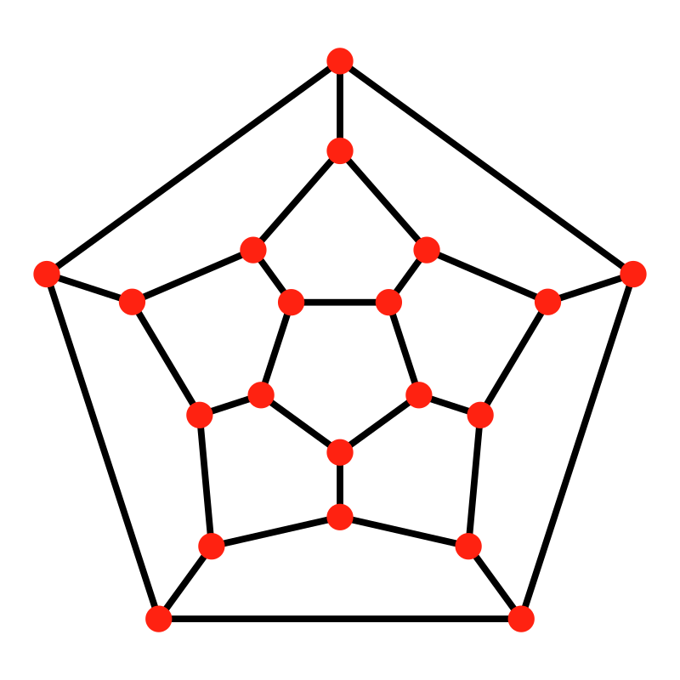
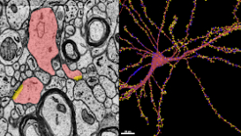
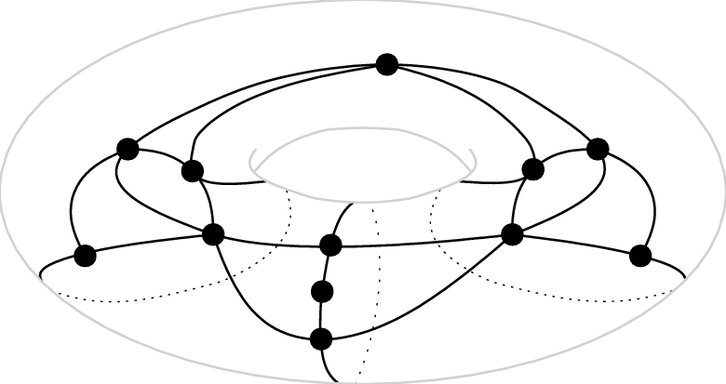

Graphs
Tristan Chaang

Slide 2
History of Graph Theory
Introduction to Graphs
Graph Algorithms
Topology of Graphs
Famous Problems

Slide 3
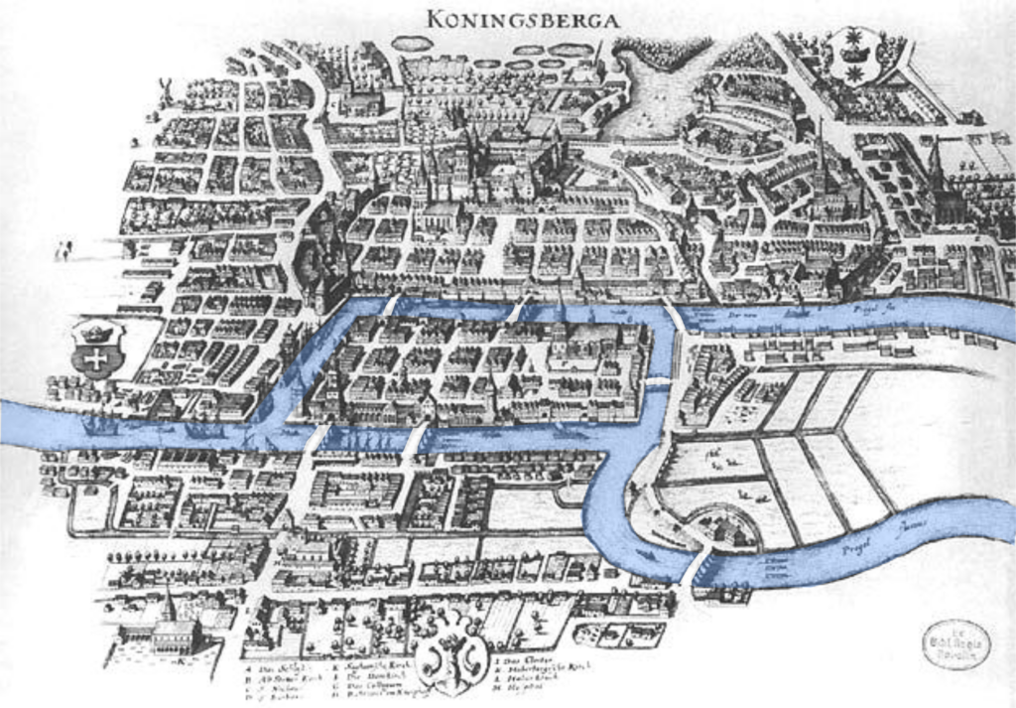

Slide 4
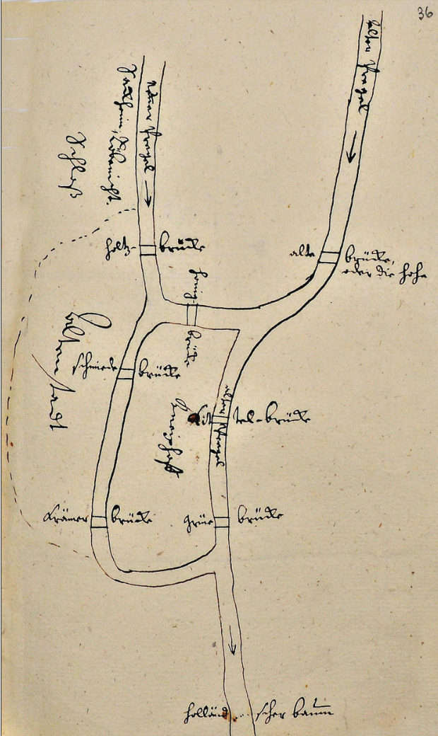
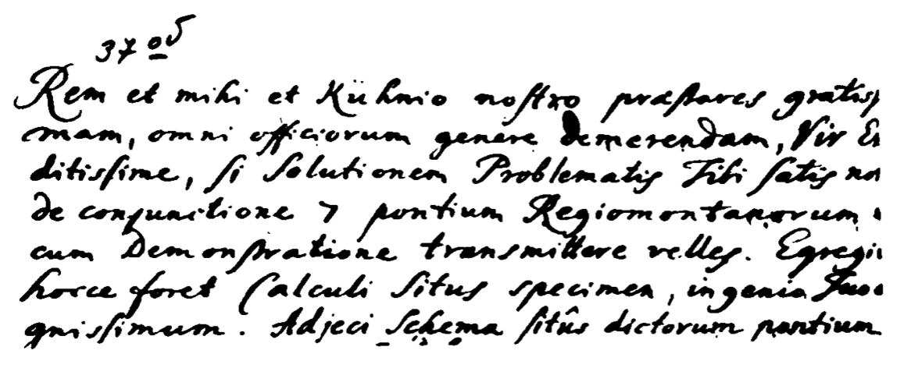


Slide 5
“You would render to me and our friend Kuhn a most valuable service, putting us greatly in your debt, most learned sir, if you would send us the solution, which you know well, to the problem of the seven Königsberg bridges together with a proof. It would prove to an outstanding example of the calculus of position [calculi situs] worthy of your great genius. I have added a sketch of the said bridges…”
Carl Gottlieb Ehler to Leonhard Euler, 1735

Slide 6
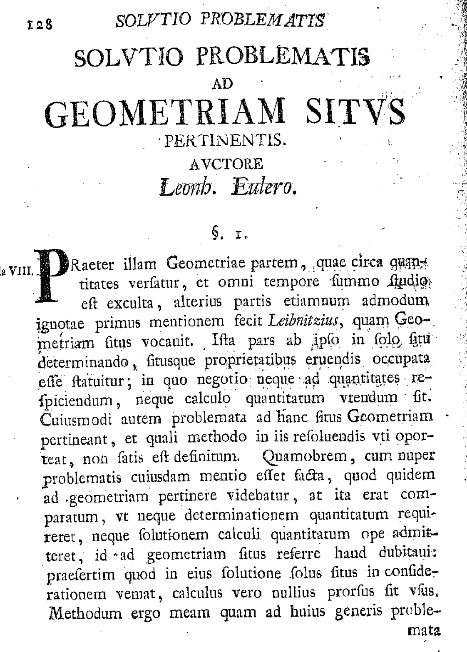


“In addition to that branch of geometry which is concerned with distances. and which has always received the greatest attention, there is another branch, hitherto almost unknown, which Leibniz first mentioned, calling it the geometry of position (Geometriam situs).”
Euler’s Paper, 1736

Slide 7
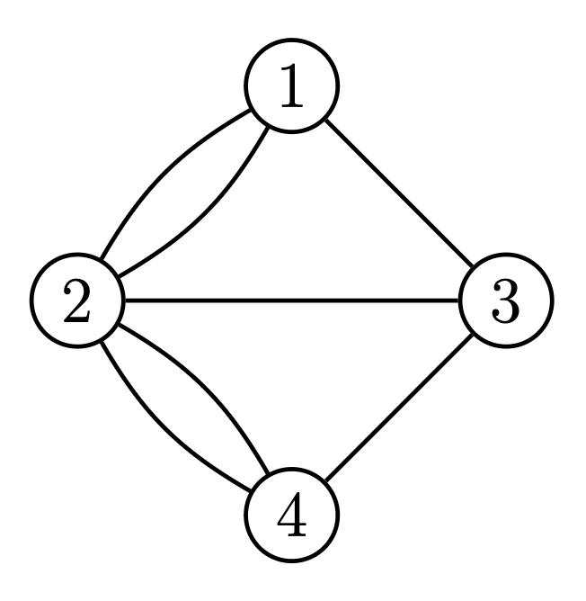
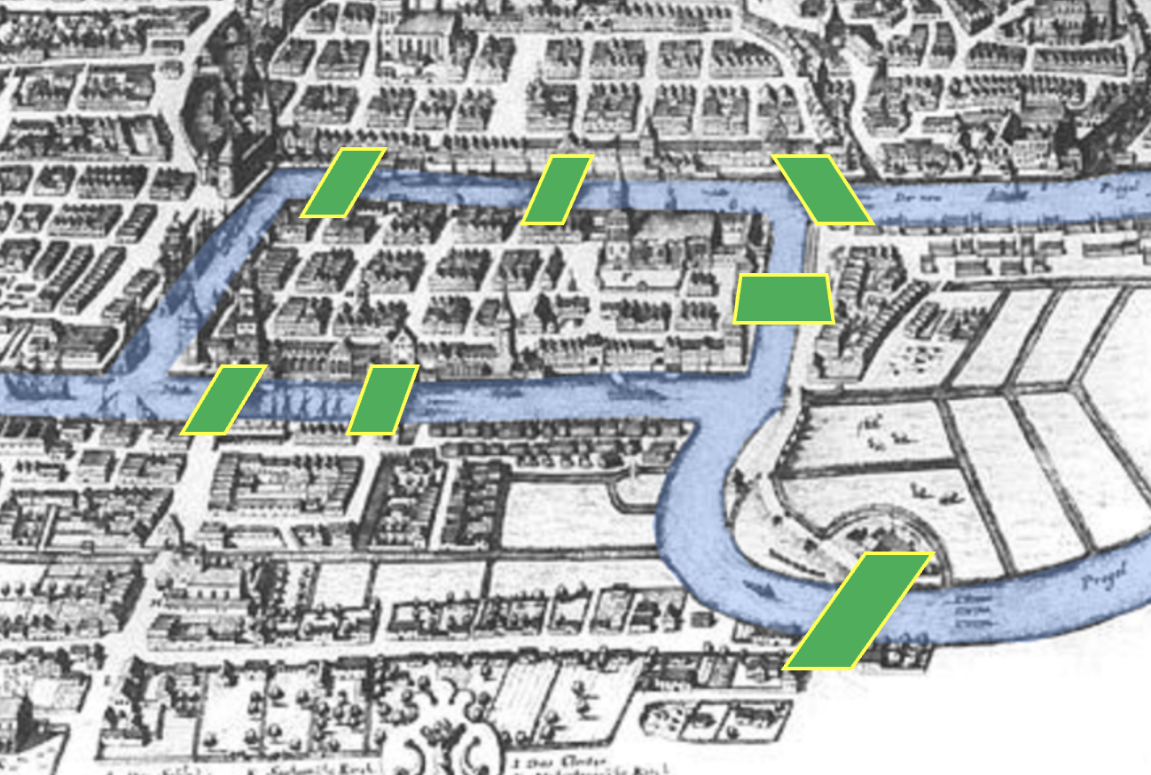

Slide 8
Introduction to Graphs

Slide 9
Graph G = (V, E)
Set V of objects called nodes (or vertices)
An edge has two endpoints that are nodes.
If undirected, do not distinguish the order of the endpoints
If directed, one endpoint is the initial and the other is the final
Can have other attributes, such as weight, color, flow, etc.
E = the set of edges

Slide 10
Is there a permutation of 1, 2, …, 15 such that any two adjacent numbers add up to a perfect square?
If yes, how many are there?

Slide 11
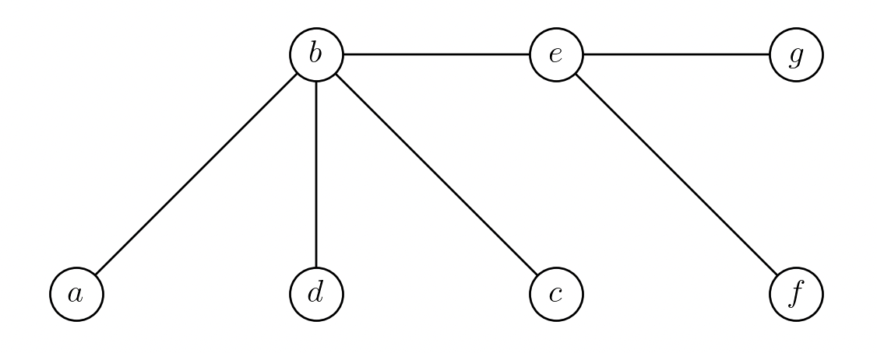
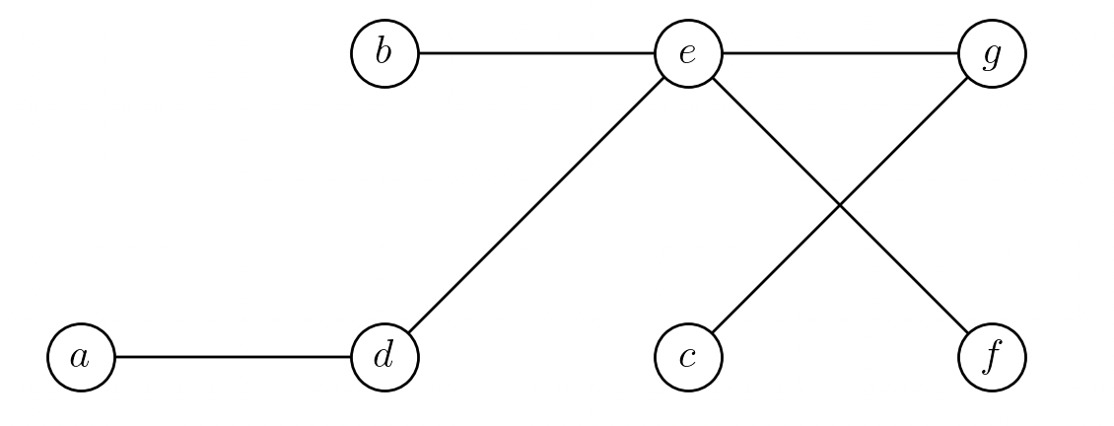
Tree
A tree is an undirected graph that
is connected (there is a path between any two nodes)
contains no cycles
A directed tree is a directed graph whose underlying undirected graph is a tree

Slide 12
Graph Algorithms

Slide 13
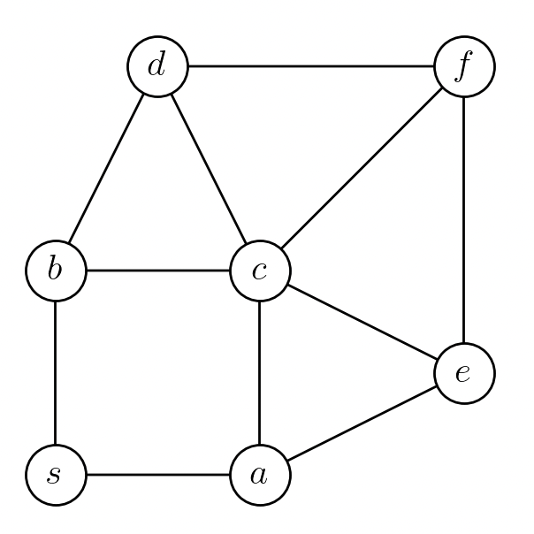
Can we go from s to f ?

Slide 14
Minimum number of edges from s to f ?

Slide 15
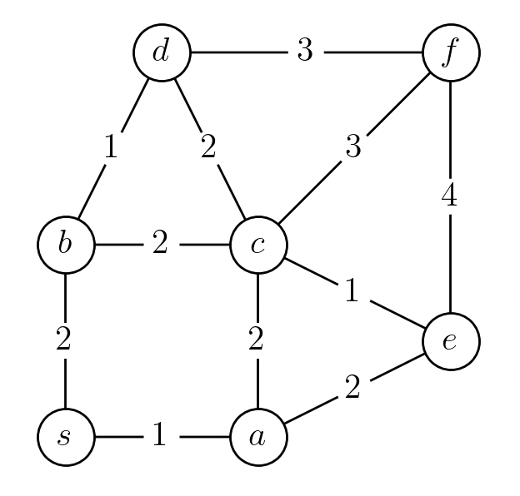
Minimum total distance from s to f ?

Slide 16
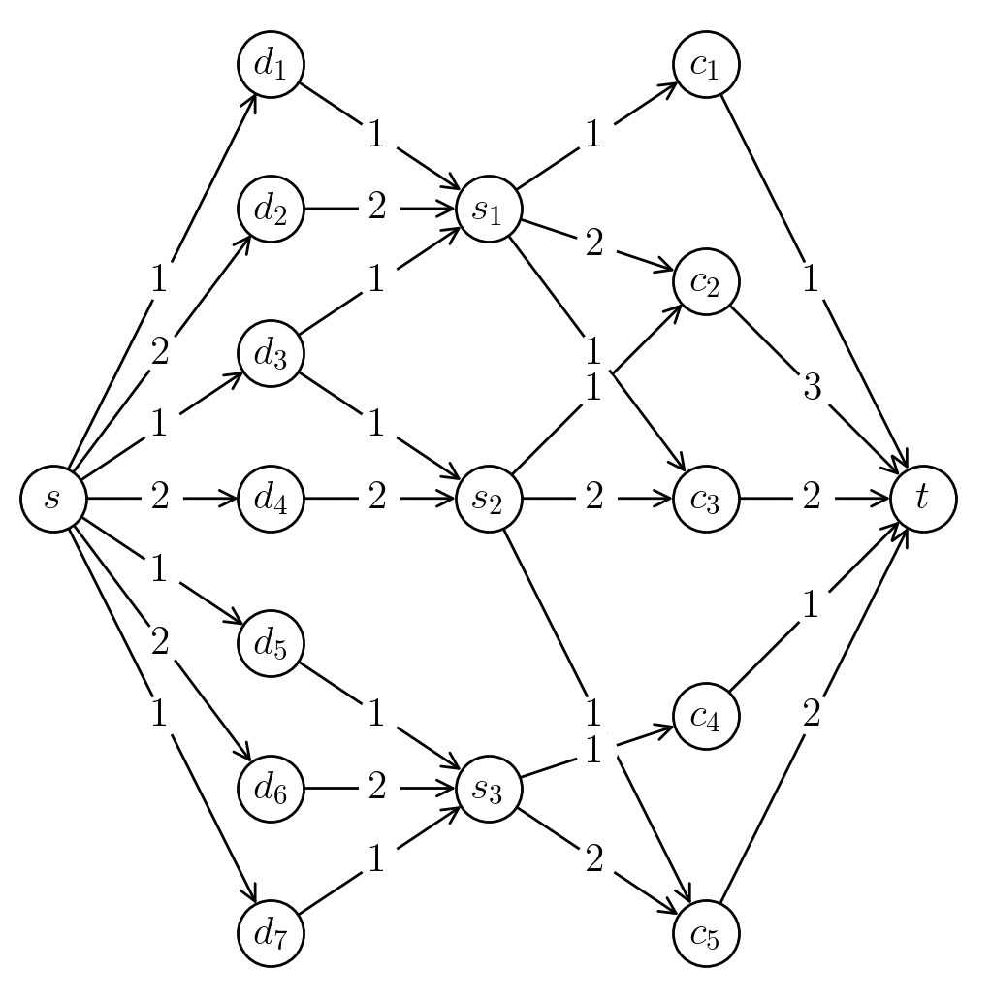
Maximum flow from s to t ?

Slide 17
Maximum number of rooks on this board with no two attacking each other?
(You cannot place a rook on any of the dark tiles)

Slide 18
Topology of Graphs

Slide 19
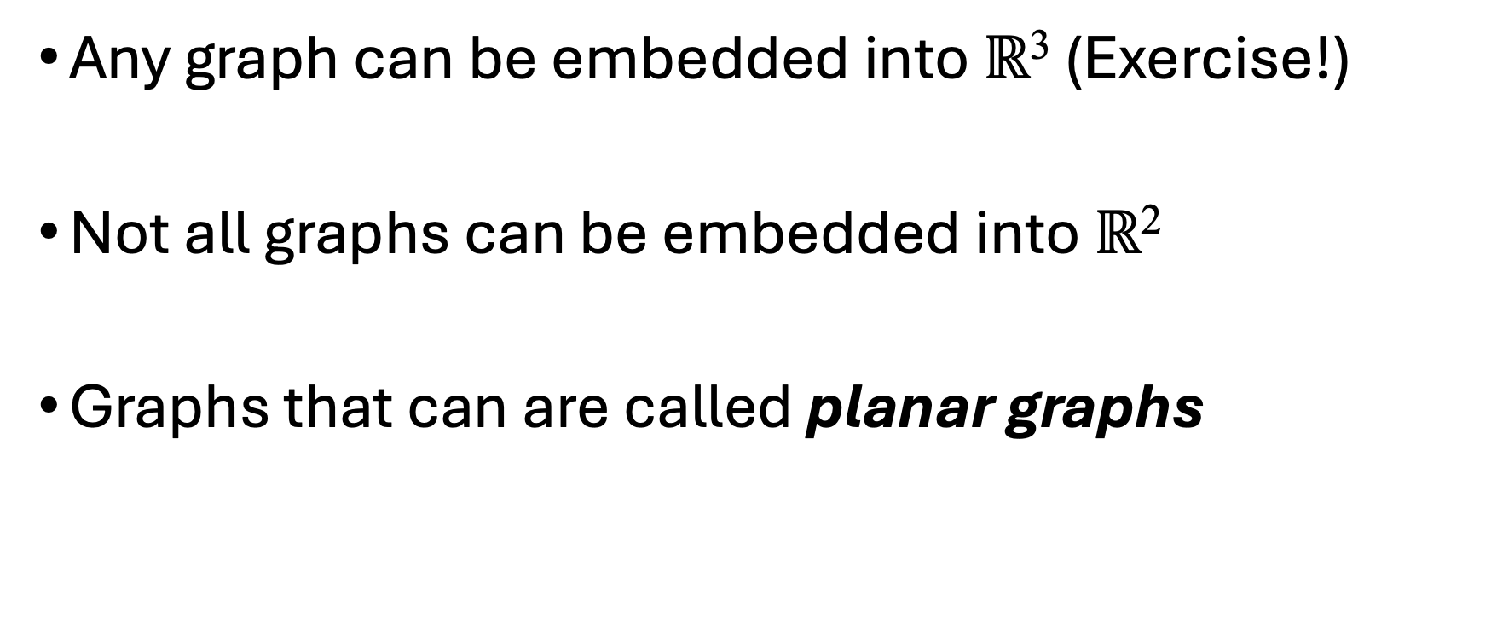
Planar Graphs
Any graph can be embedded into $ℝ$³ (Exercise!)
Not all graphs can be embedded into $ℝ$²
Graphs that can are called planar graphs

Slide 20
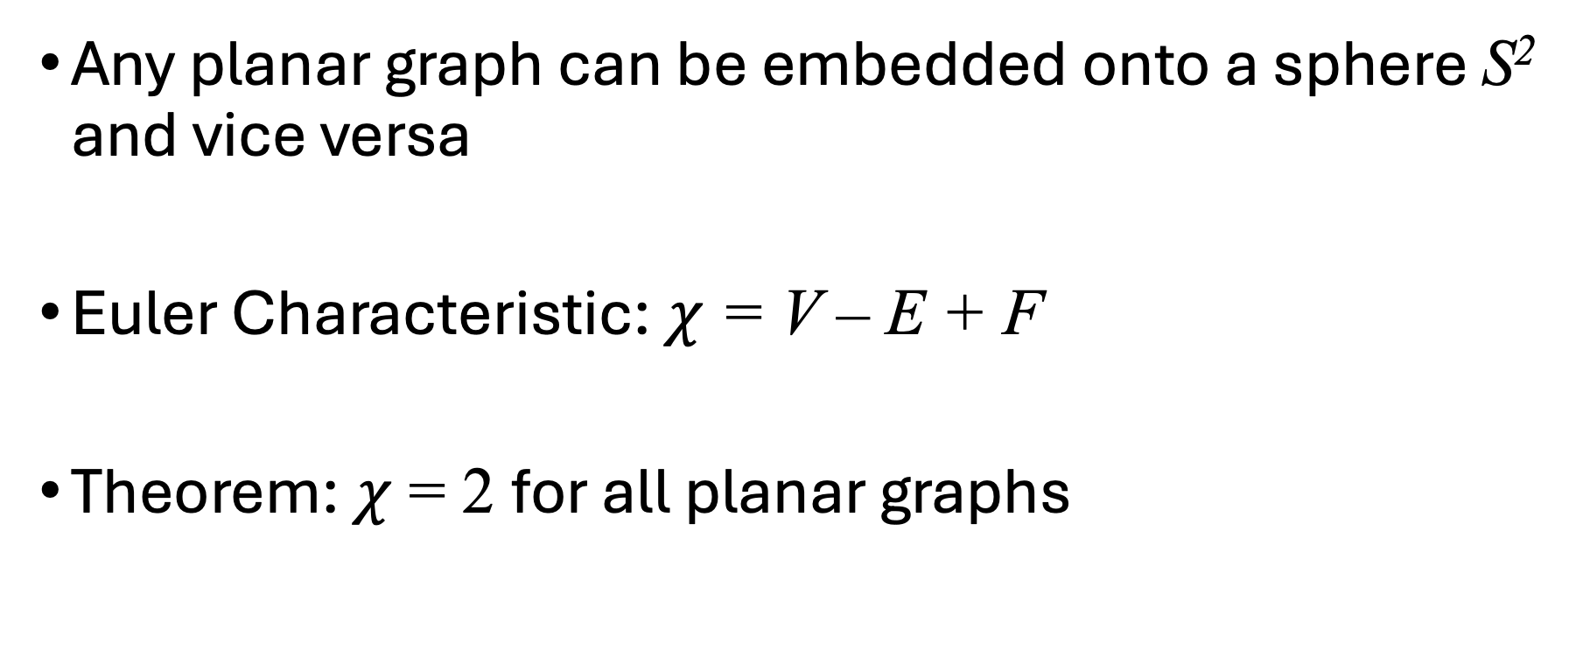
Planar Graphs
Any planar graph can be embedded onto a sphere S² and vice versa
Euler Characteristic: $χ$ = V – E + F
Theorem: $χ$ = 2 for all planar graphs

Slide 21
Connect similar shapes

Slide 22




Three Utilities Problem

Slide 23
Three Utilities Problem

Slide 24
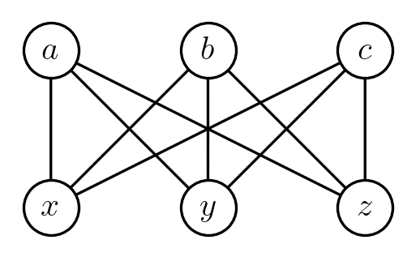
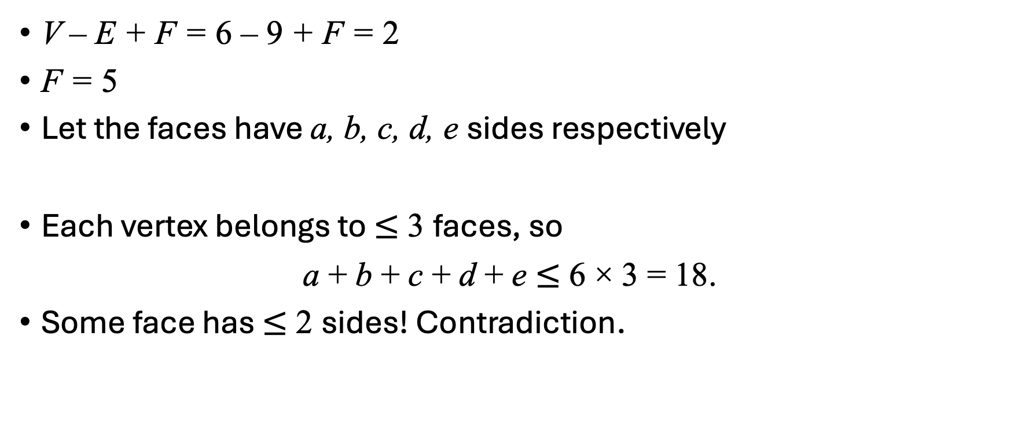
Is K_{3,3} planar?
V – E + F = 6 – 9 + F = 2
F = 5
Let the faces have a, b, c, d, e sides respectively
Each vertex belongs to $≤$ 3 faces, so
a + b + c + d + e $≤$ 6 × 3 = 18.
Some face has $≤$ 2 sides! Contradiction.

Slide 25

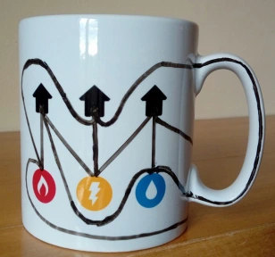
Source: Maths Gear

Slide 26
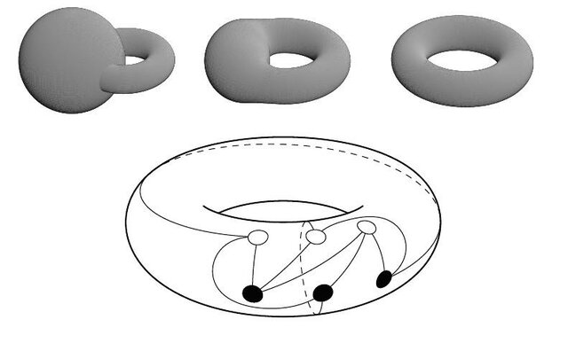
Source: Emroz Khan
researchgate.net

Slide 27
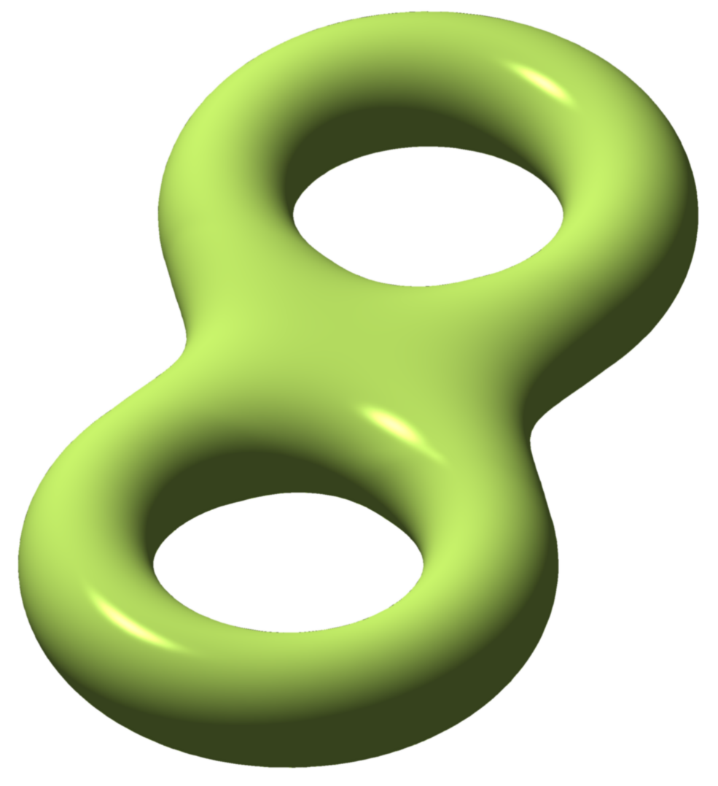
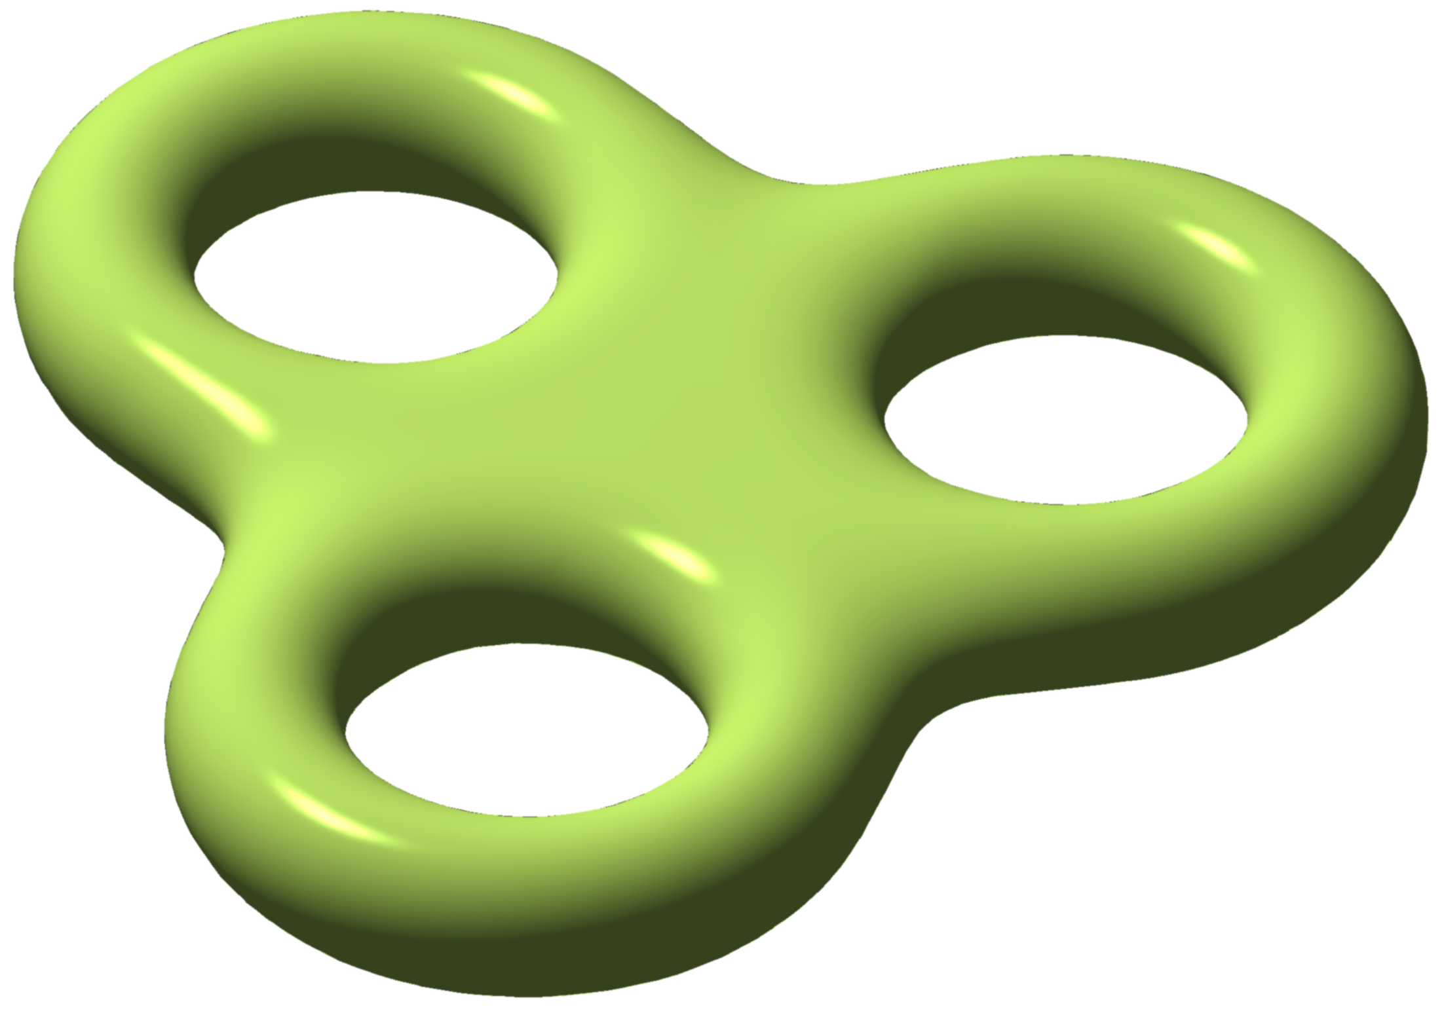
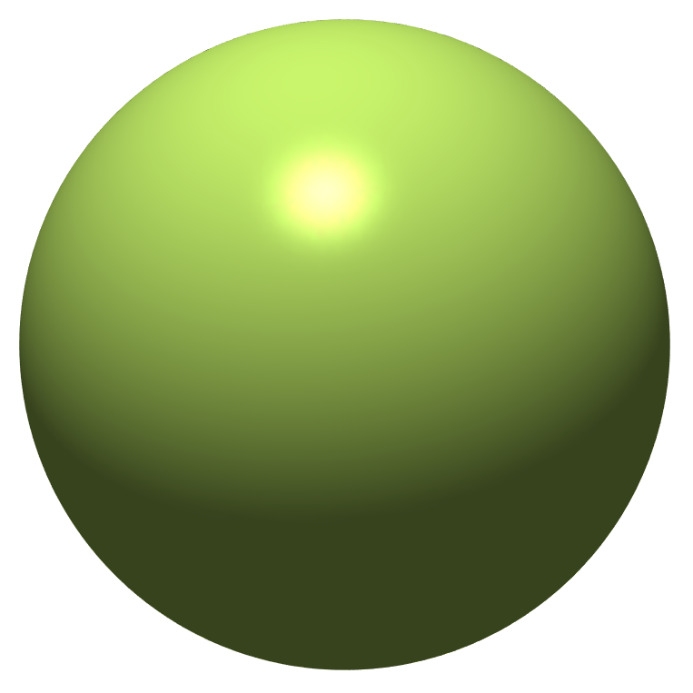
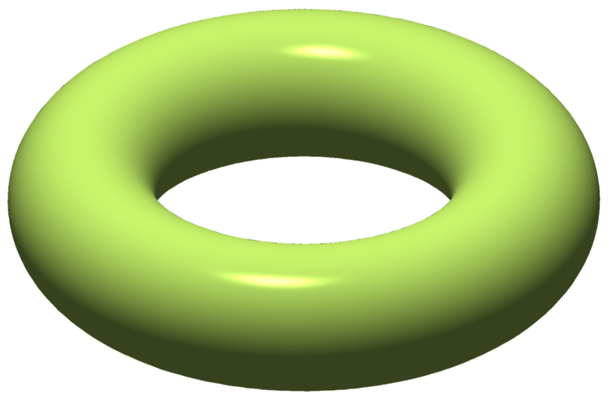
Graph genus
0
1
2
3
Genus g surface
Source: Wikipedia, Genus (Mathematics)

Slide 28
Four-Color Theorem
All planar graphs are 4-colorable
Needed to check 1834 cases. Took > 1000 hours by computer.

Slide 29
Famous Problems

Slide 30
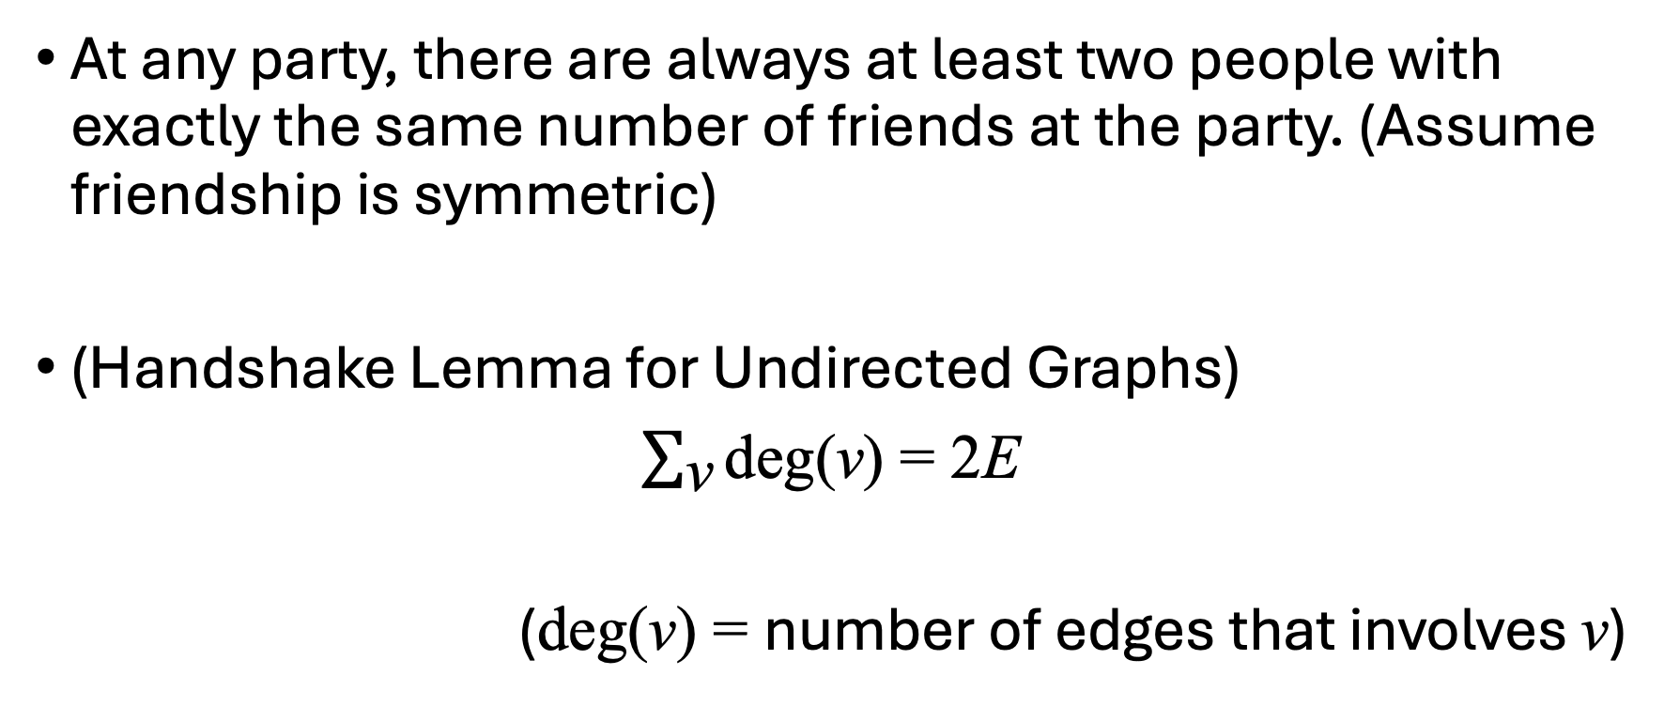
Warmup Olympiad Problems
At any party, there are always at least two people with exactly the same number of friends at the party. (Assume friendship is symmetric)
(Handshake Lemma for Undirected Graphs)
$\sum_{\text{v}}{\text{deg}\text{(}\text{v}\text{)}}$ = 2E
(deg(v) = number of edges that involves v)

Slide 31
Turán Problem
Given a fixed number of nodes, what is the maximum number of edges to draw so that there are no k-cliques?

Slide 32
Ramsey Coloring Problem
There is always a monochromatic k-clique in a sufficiently large complete graph whose edges are colored one of 2 colors.
R(k) = minimum size of the complete graph where the above is true
(It should be R(k, k), but we keep the notation simple here)
R(3) = 6
R(4) = 18
R(5) = ? (but shown between 43 and 48)

Slide 33
Maximum Clique Problem
Given a graph, what’s the size of its biggest clique?
NP-Complete

Slide 34
https://tristanchaang.github.io
Thank you

